Slide 1

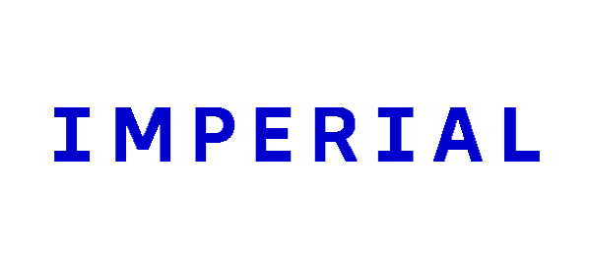
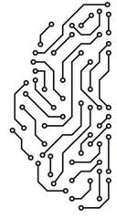
Digital Phenotyping in Bipolar Disorder
Filippo Corponi
MD, MSc, PhD
1

Slide 2
Programme
Digital Phenotyping
2

Slide 3
Programme
Digital Phenotyping
AI Nuts ‘N’ Bolts
3

Slide 4

Programme
Digital Phenotyping
AI Nuts ‘N’ Bolts
Are you nuts?!?!
4

Slide 5
Programme
Digital Phenotyping
AI Nuts ‘N’ Bolts
Bipolar Disorder as a Use Case
Are you nuts?!?!
5

Slide 6
Digital Phenotyping
Moment-by-moment quantification of the individual-level human phenotype in-situ using data from smartphones and other personal digital devices.
Torous et al., JMIR Ment Health, 2016
6

Slide 7
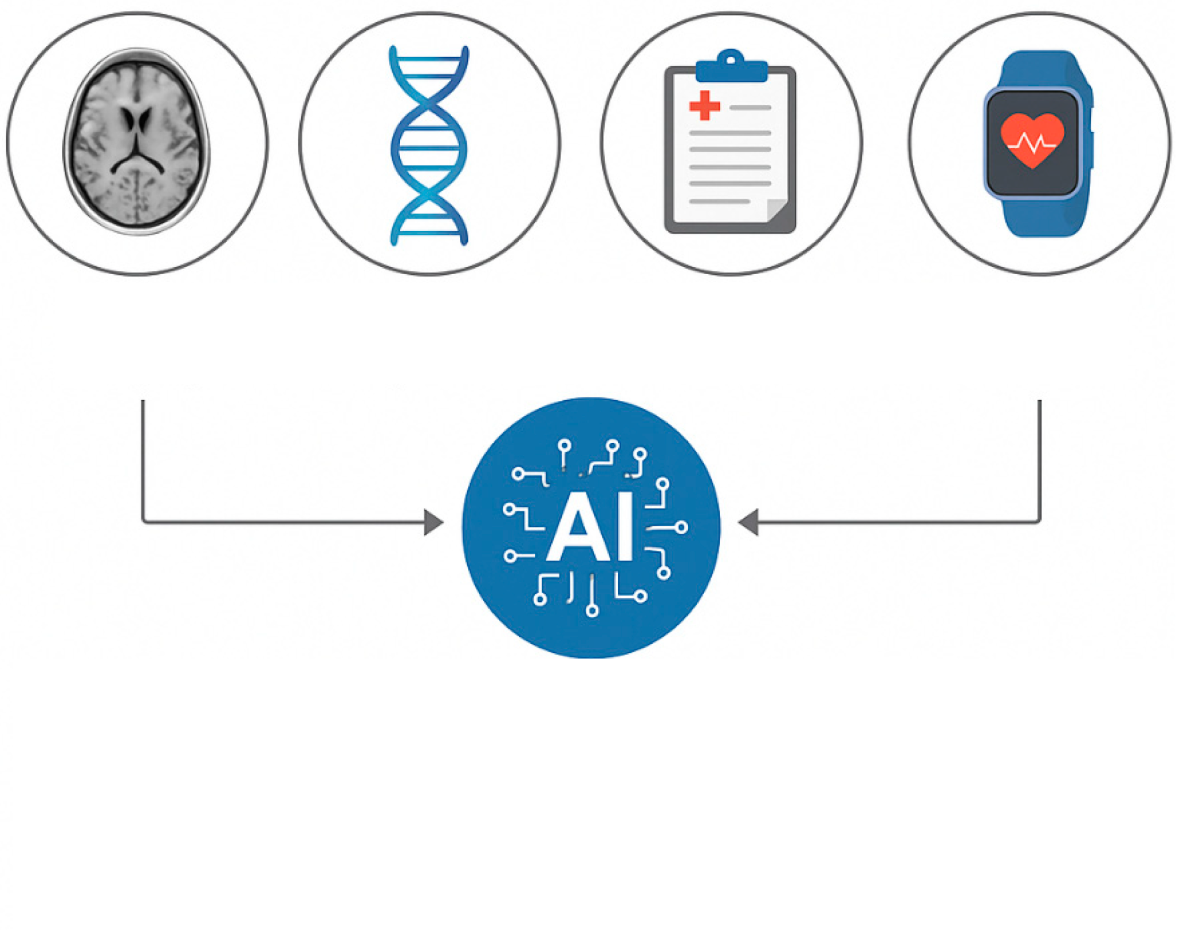
Digital Phenotyping
Moment-by-moment quantification of the individual-level human phenotype in-situ using data from smartphones and other personal digital devices.
Torous et al., JMIR Ment Health, 2016
7

Slide 8
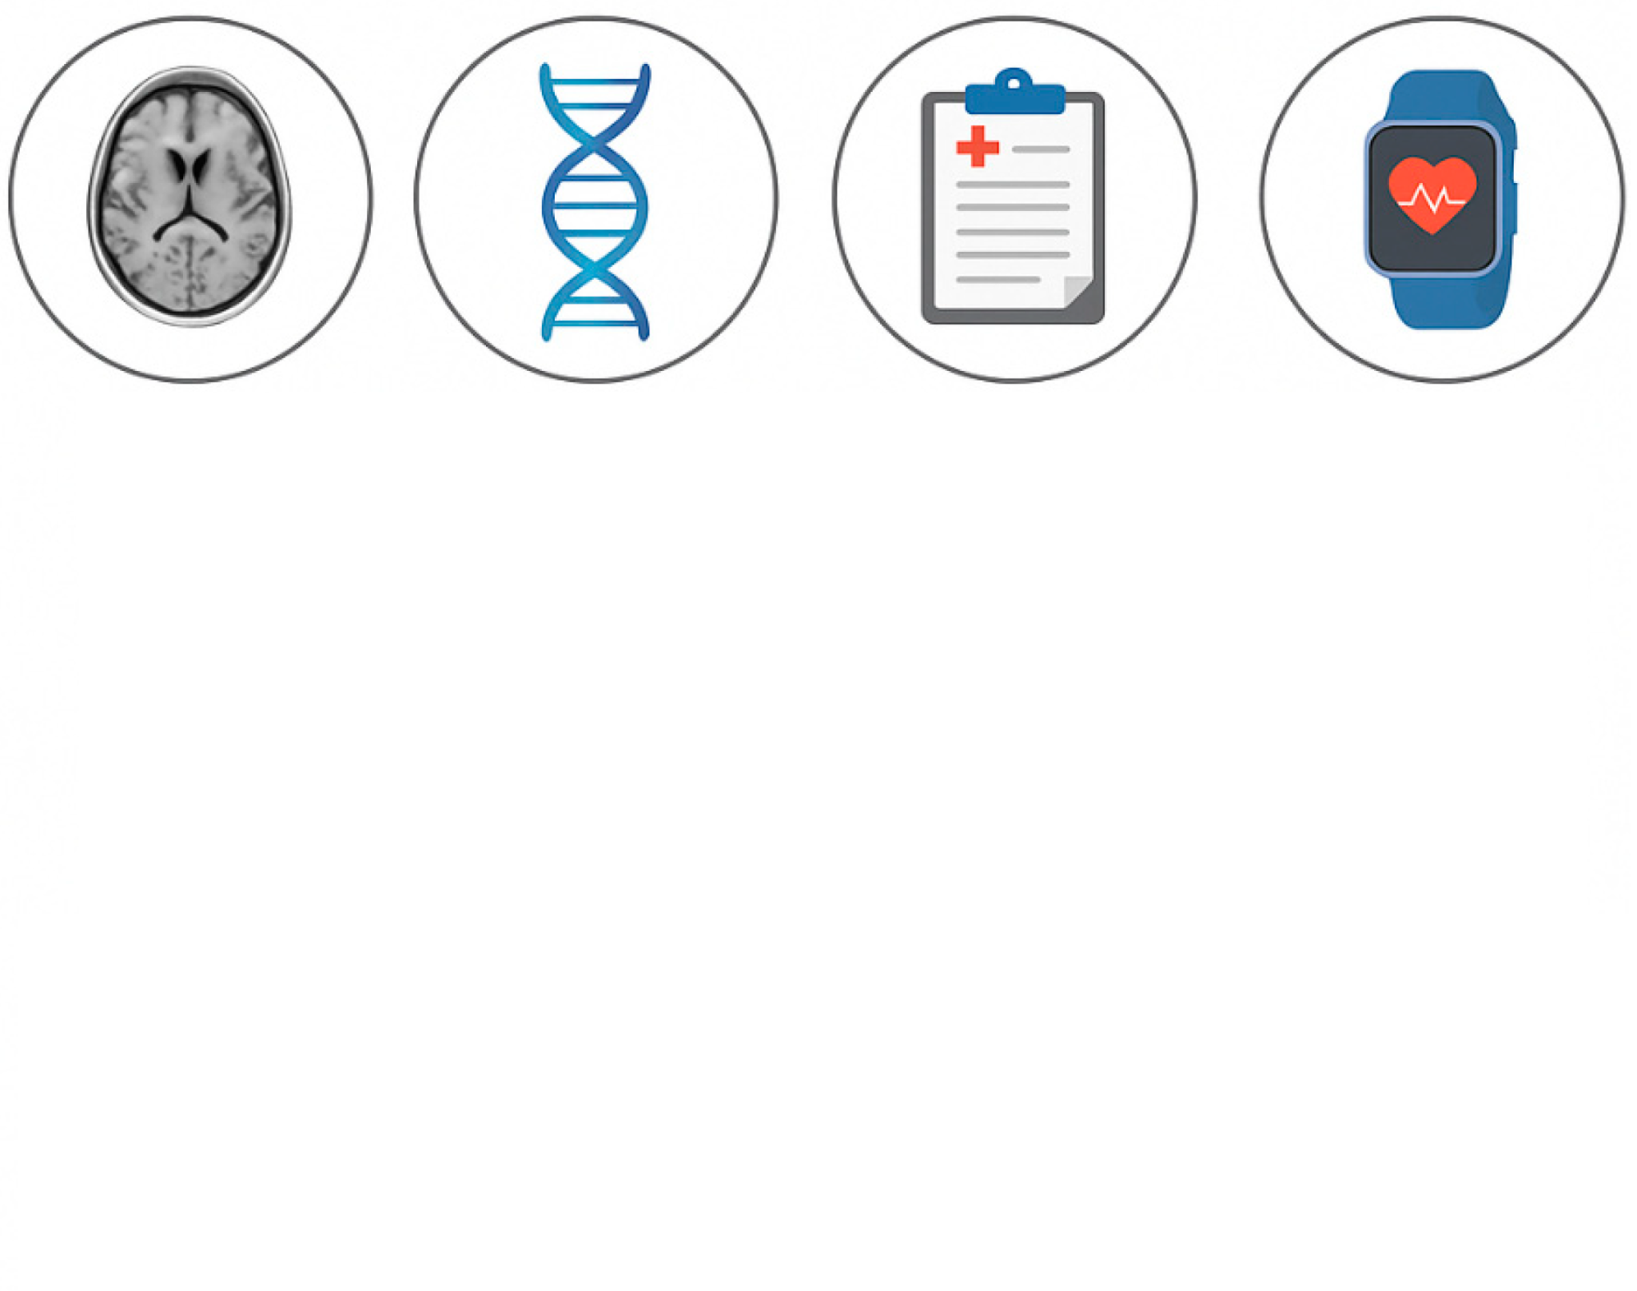
Digital Phenotyping
Moment-by-moment quantification of the individual-level human phenotype in-situ using data from smartphones and other personal digital devices.
Torous et al., JMIR Ment Health, 2016
8

Slide 9
Digital Phenotyping
Moment-by-moment quantification of the individual-level human phenotype in-situ using data from smartphones and other personal digital devices.
Torous et al., JMIR Ment Health, 2016
Digital interventions are the most promising way to reduce the global mental health burden
WHO, Recommendations on digital interventions for health system strengthening, 2020
9

Slide 10
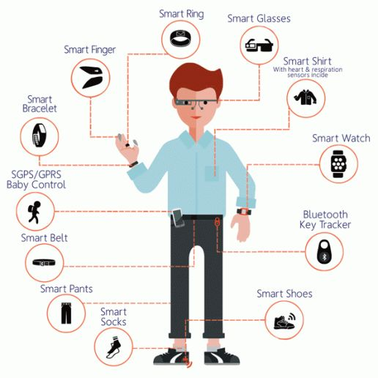
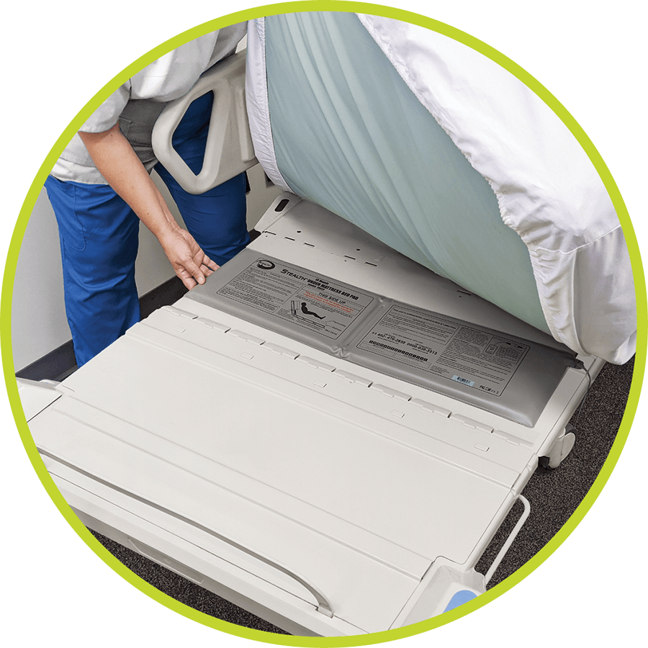
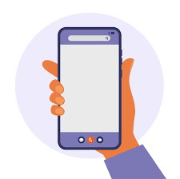
Digital Phenotyping
Wearables
Nearables
Smartphone
10

Slide 11
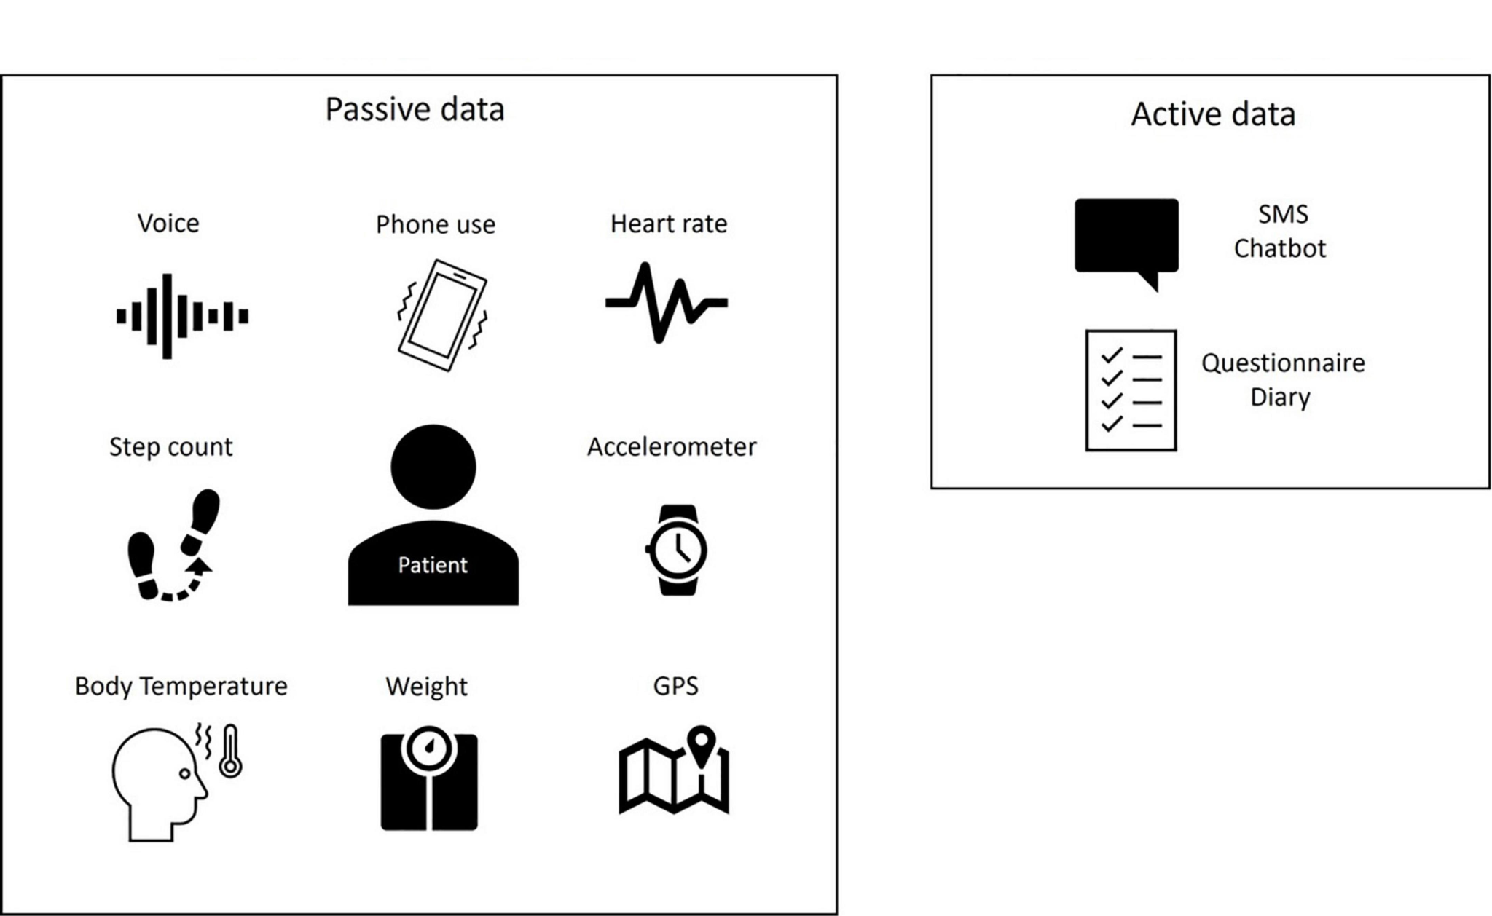
Digital Phenotyping
Maatoug et al., Frontiers in Psychiatry, 2022
11

Slide 12
Digital Phenotyping
The case for wrist-worn devices
98% smartphone owners
59% wearable owners
Shandhi et al., npj Digit. Med., 2024
12

Slide 13


Digital Phenotyping
The case for wrist-worn devices
Call logs
App usage
Speech data
Acceleration
Skin temperature
Electrodermal reactivity
ECG
13

Slide 14

Digital Phenotyping
The case for wrist-worn devices
Call logs
App usage
Speech data
Acceleration
Skin temperature
Electrodermal reactivity
ECG
Confidentiality
Acceptability & Harm
14

Slide 15
Digital Phenotyping
Moment-by-moment quantification of the individual-level human phenotype in-situ using data from smartphones and other personal digital devices.
Torous et al., JMIR Ment Health 2016
15

Slide 16
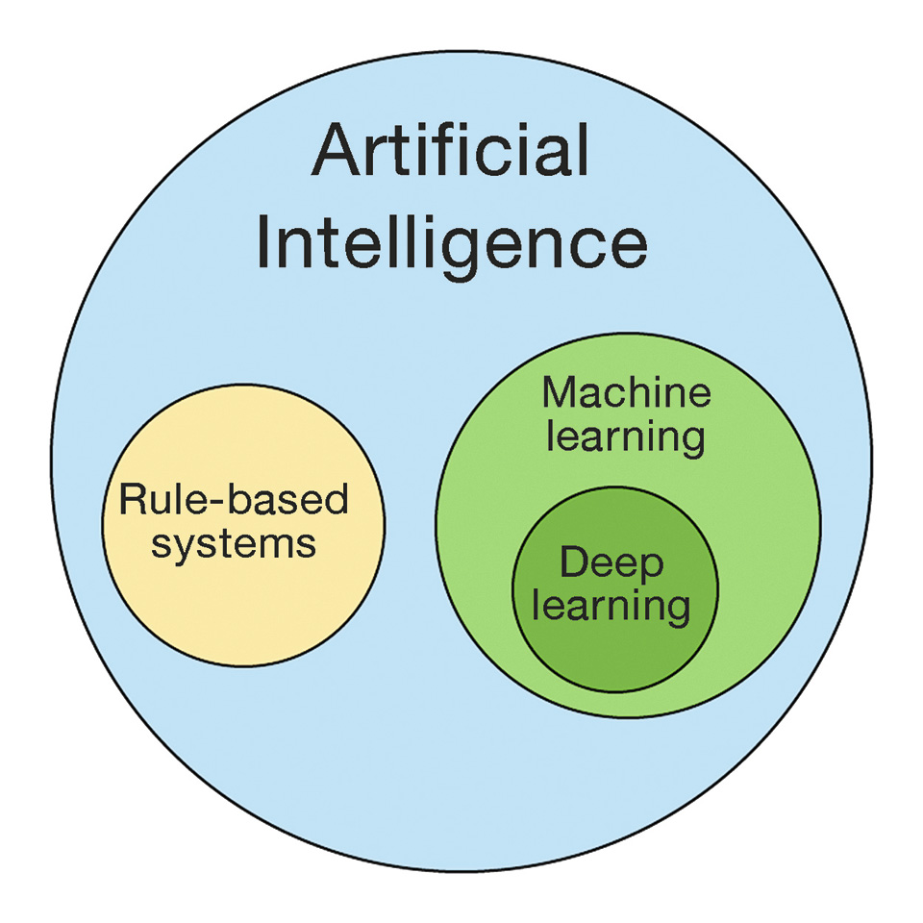
AI Nuts ‘N’ Bolts
16

Slide 17
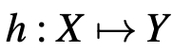
AI Nuts ‘N’ Bolts
Supervised Learning
17

Slide 18
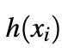
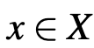
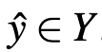
AI Nuts ‘N’ Bolts
Supervised Learning
18

Slide 19
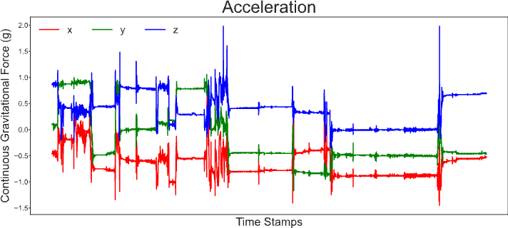
AI Nuts ‘N’ Bolts
Supervised Learning
19

Slide 20
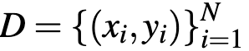
AI Nuts ‘N’ Bolts
Supervised Learning
Training Set
20

Slide 21
AI Nuts ‘N’ Bolts
Supervised Learning
Empirical Risk Minimization
21

Slide 22
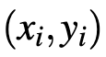
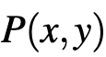
AI Nuts ‘N’ Bolts
Supervised Learning
Empirical Risk Minimization
independent identically distributed
22

Slide 23
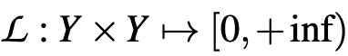
AI Nuts ‘N’ Bolts
Supervised Learning
Empirical Risk Minimization
independent identically distributed
Loss function
23

Slide 24
AI Nuts ‘N’ Bolts
Supervised Learning
Empirical Risk Minimization
24

Slide 25
AI Nuts ‘N’ Bolts
Supervised Learning
Empirical Risk Minimization
25

Slide 26
AI Nuts ‘N’ Bolts
Supervised Learning
Empirical Risk Minimization
26

Slide 27
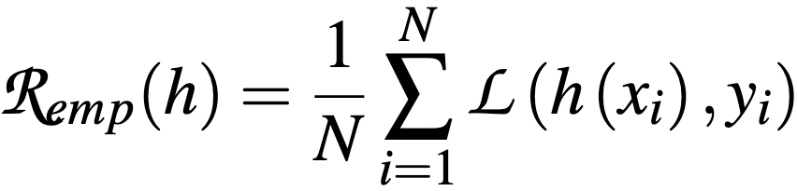
AI Nuts ‘N’ Bolts
Supervised Learning
Empirical Risk Minimization
27

Slide 28
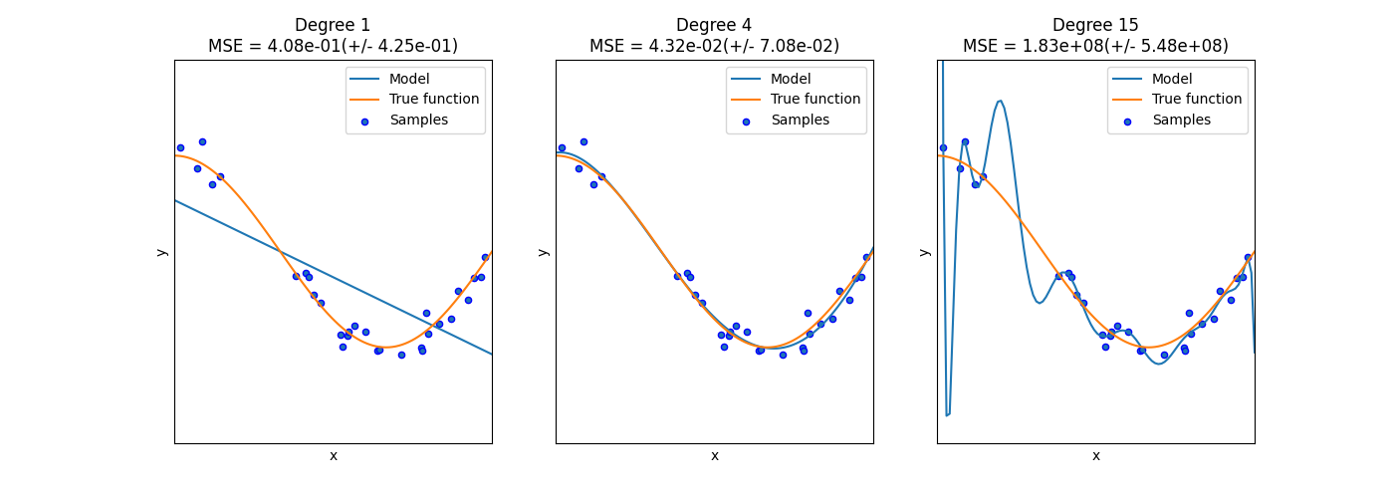
AI Nuts ‘N’ Bolts
Supervised Learning
Empirical Risk Minimization
28

Slide 29
AI Nuts ‘N’ Bolts
Supervised Learning
Empirical Risk Minimization
Overfitting
29

Slide 30
AI Nuts ‘N’ Bolts
Supervised Learning
Empirical Risk Minimization
Underfitting
Overfitting
30

Slide 31
AI Nuts ‘N’ Bolts
Supervised Learning
Issues in bipolar disorder
Labels are resource intensive
31

Slide 32
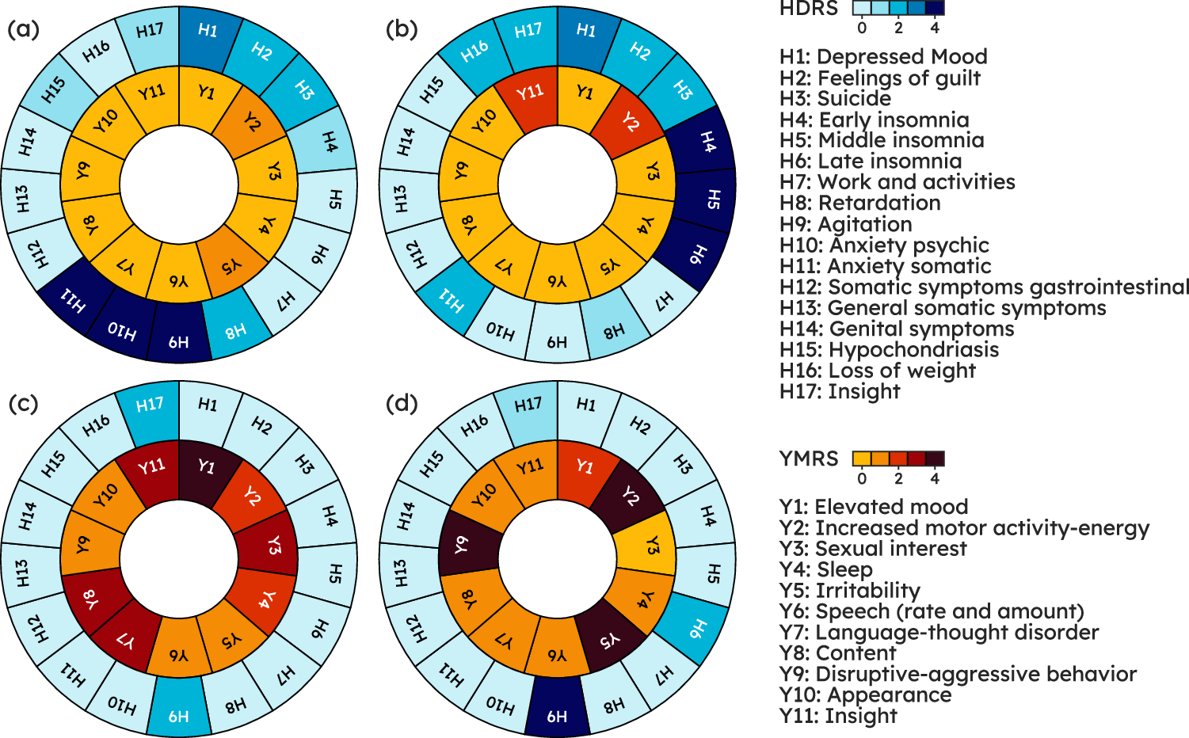
AI Nuts ‘N’ Bolts
Supervised Learning
Issues in bipolar disorder
Labels are resource intensive
Labels are noisy
32

Slide 33
AI Nuts ‘N’ Bolts
Supervised Learning
Issues in bipolar disorder
Labels are resource intensive
Labels are noisy
Labels are imprecise regarding specific recording segments
33

Slide 34
AI Nuts ‘N’ Bolts
Unsupervised Learning
34

Slide 35
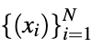
AI Nuts ‘N’ Bolts
Unsupervised Learning
35

Slide 36

AI Nuts ‘N’ Bolts
Unsupervised Learning
Clustering
36

Slide 37
AI Nuts ‘N’ Bolts
Unsupervised Learning
Clustering
37

Slide 38
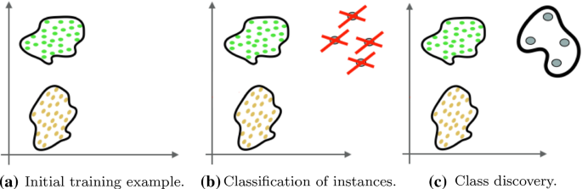
AI Nuts ‘N’ Bolts
Unsupervised Learning
Novelty Detection
38

Slide 39
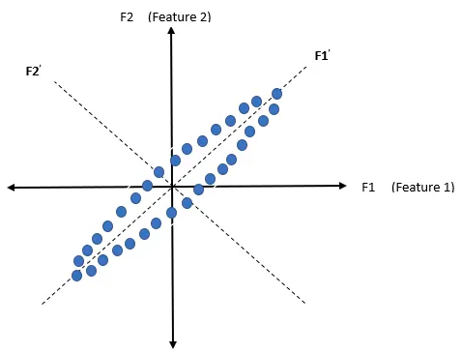
AI Nuts ‘N’ Bolts
Unsupervised Learning
Dimensionality Reduction
39

Slide 40
AI Nuts ‘N’ Bolts
Representation Learning vs Feature Engineering
40

Slide 41
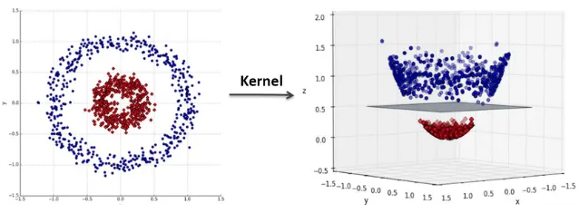
AI Nuts ‘N’ Bolts
Representation Learning vs Feature Engineering
41

Slide 42

AI Nuts ‘N’ Bolts
Representation Learning vs Feature Engineering
42

Slide 43

Bipolar Disorder as a Use Case
Bipolar is a Prevalent (~1%) and Severe Psychiatric Disorder
New Disease Episodes Heaviest Contributors to Disease Burden
Early Dectection
Early Interventions
Better Outcomes
43

Slide 44
Bipolar Disorder as a Use Case
Bipolar is a Prevalent (~1%) and Severe Psychiatric Disorder
New Disease Episodes Heaviest Contributors to Disease Burden
Early Detection is Hard
Early Dectection
Early Interventions
Better Outcomes
44

Slide 45
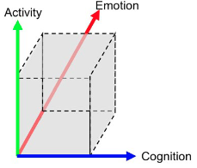
Bipolar Disorder as a Use Case
Malhi et al., Bipolar disorders, 2018
45

Slide 46



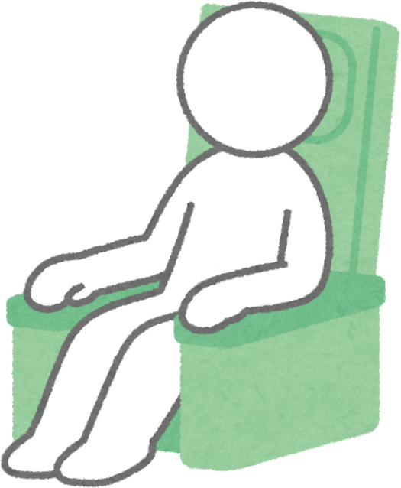






Bipolar Disorder as a Use Case
A Patient with Bipolar in Their Life
activity
time
Region of normal activity levels
46

Slide 47
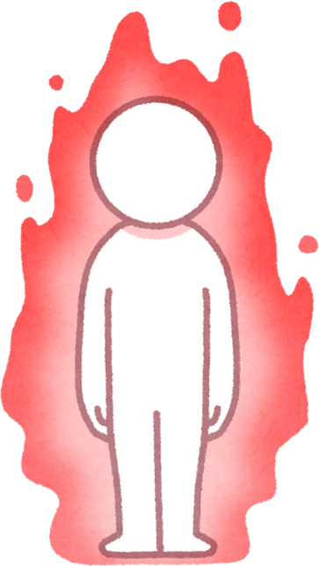
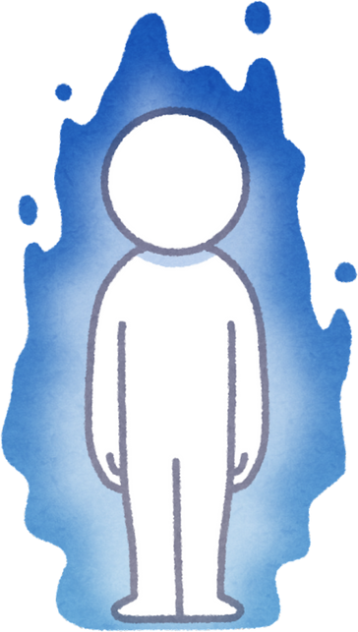
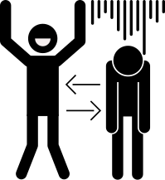

Bipolar Disorder as a Use Case
Acute Episodes
Lasting Days
A Patient with Bipolar in Their Life
Significant Impairment
activity
time
Region of normal activity levels
47

Slide 48
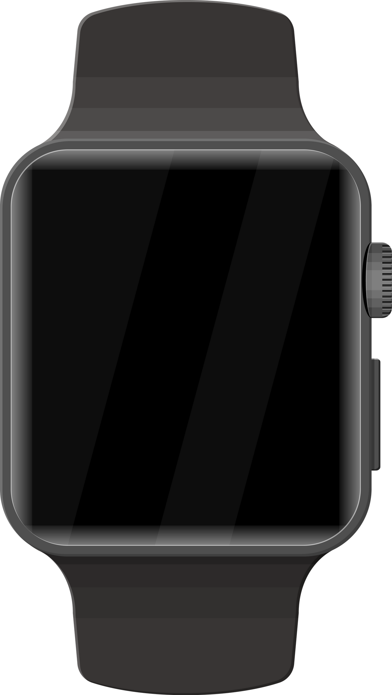


Bipolar Disorder as a Use Case
activity
acceleration
Acceleration ≈ Activity
time
time
48

Slide 49
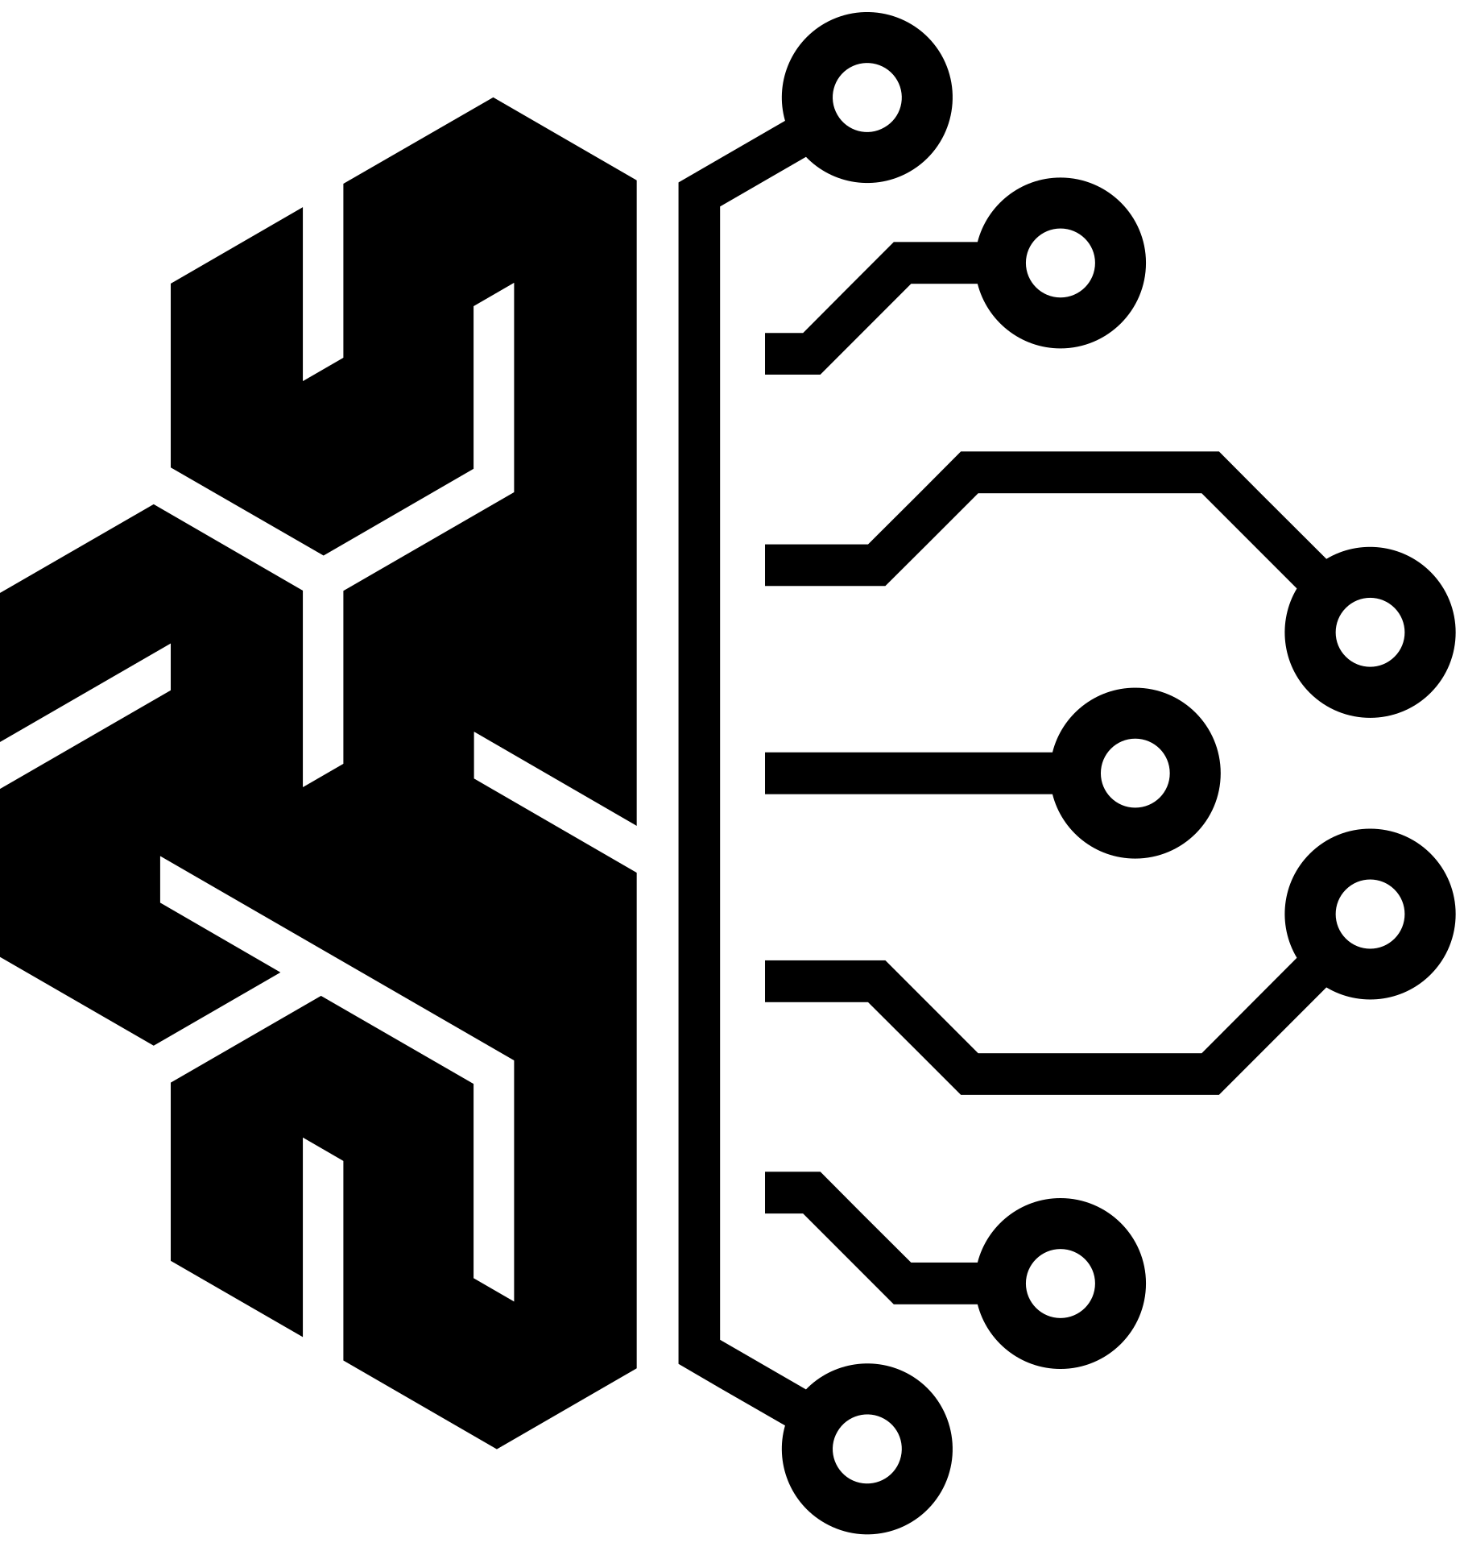

Bipolar Disorder as a Use Case
49

Slide 50
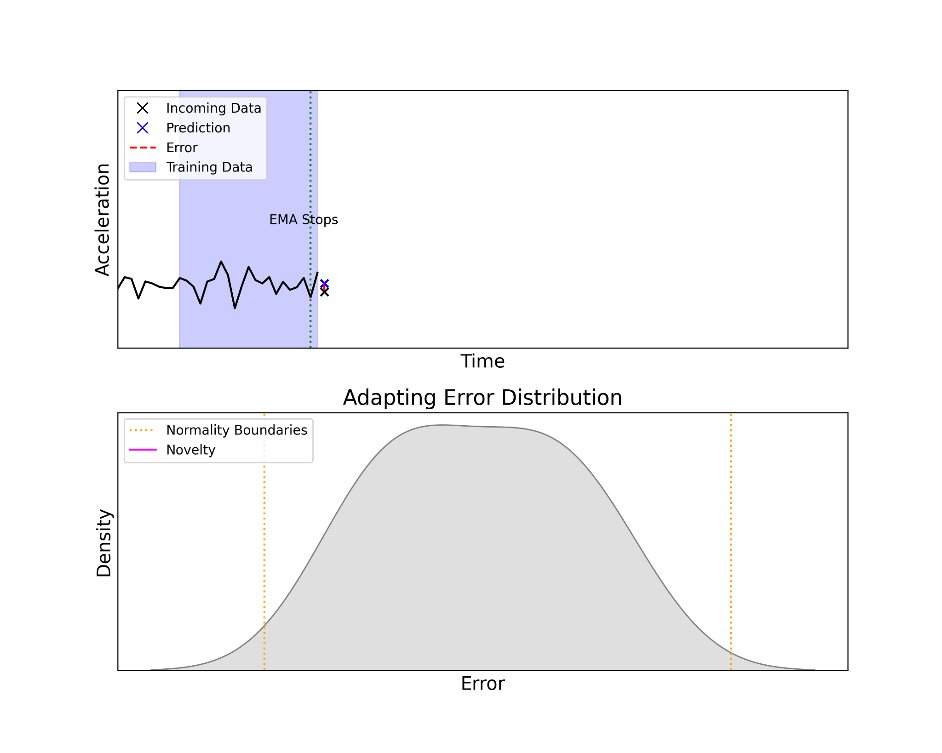
Bipolar Disorder as a Use Case
Novelty Detection
50

Slide 51
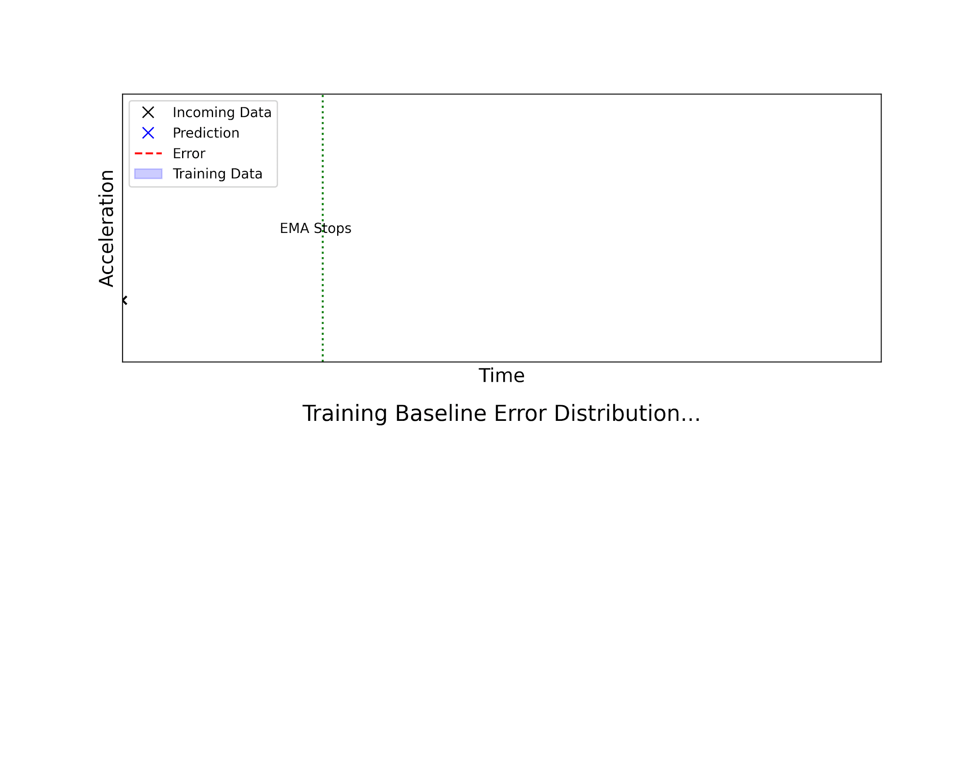
Bipolar Disorder as a Use Case
Novelty Detection
51

Slide 52
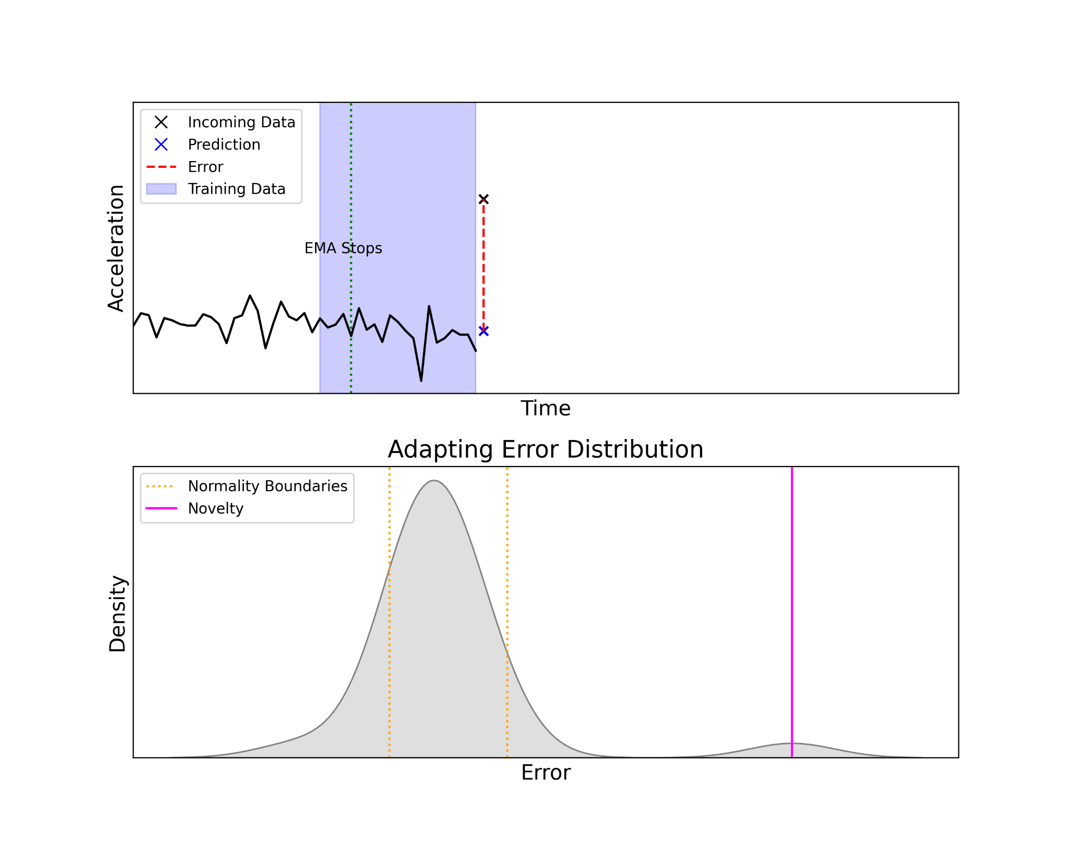
Bipolar Disorder as a Use Case
Novelty Detection
52

Slide 53
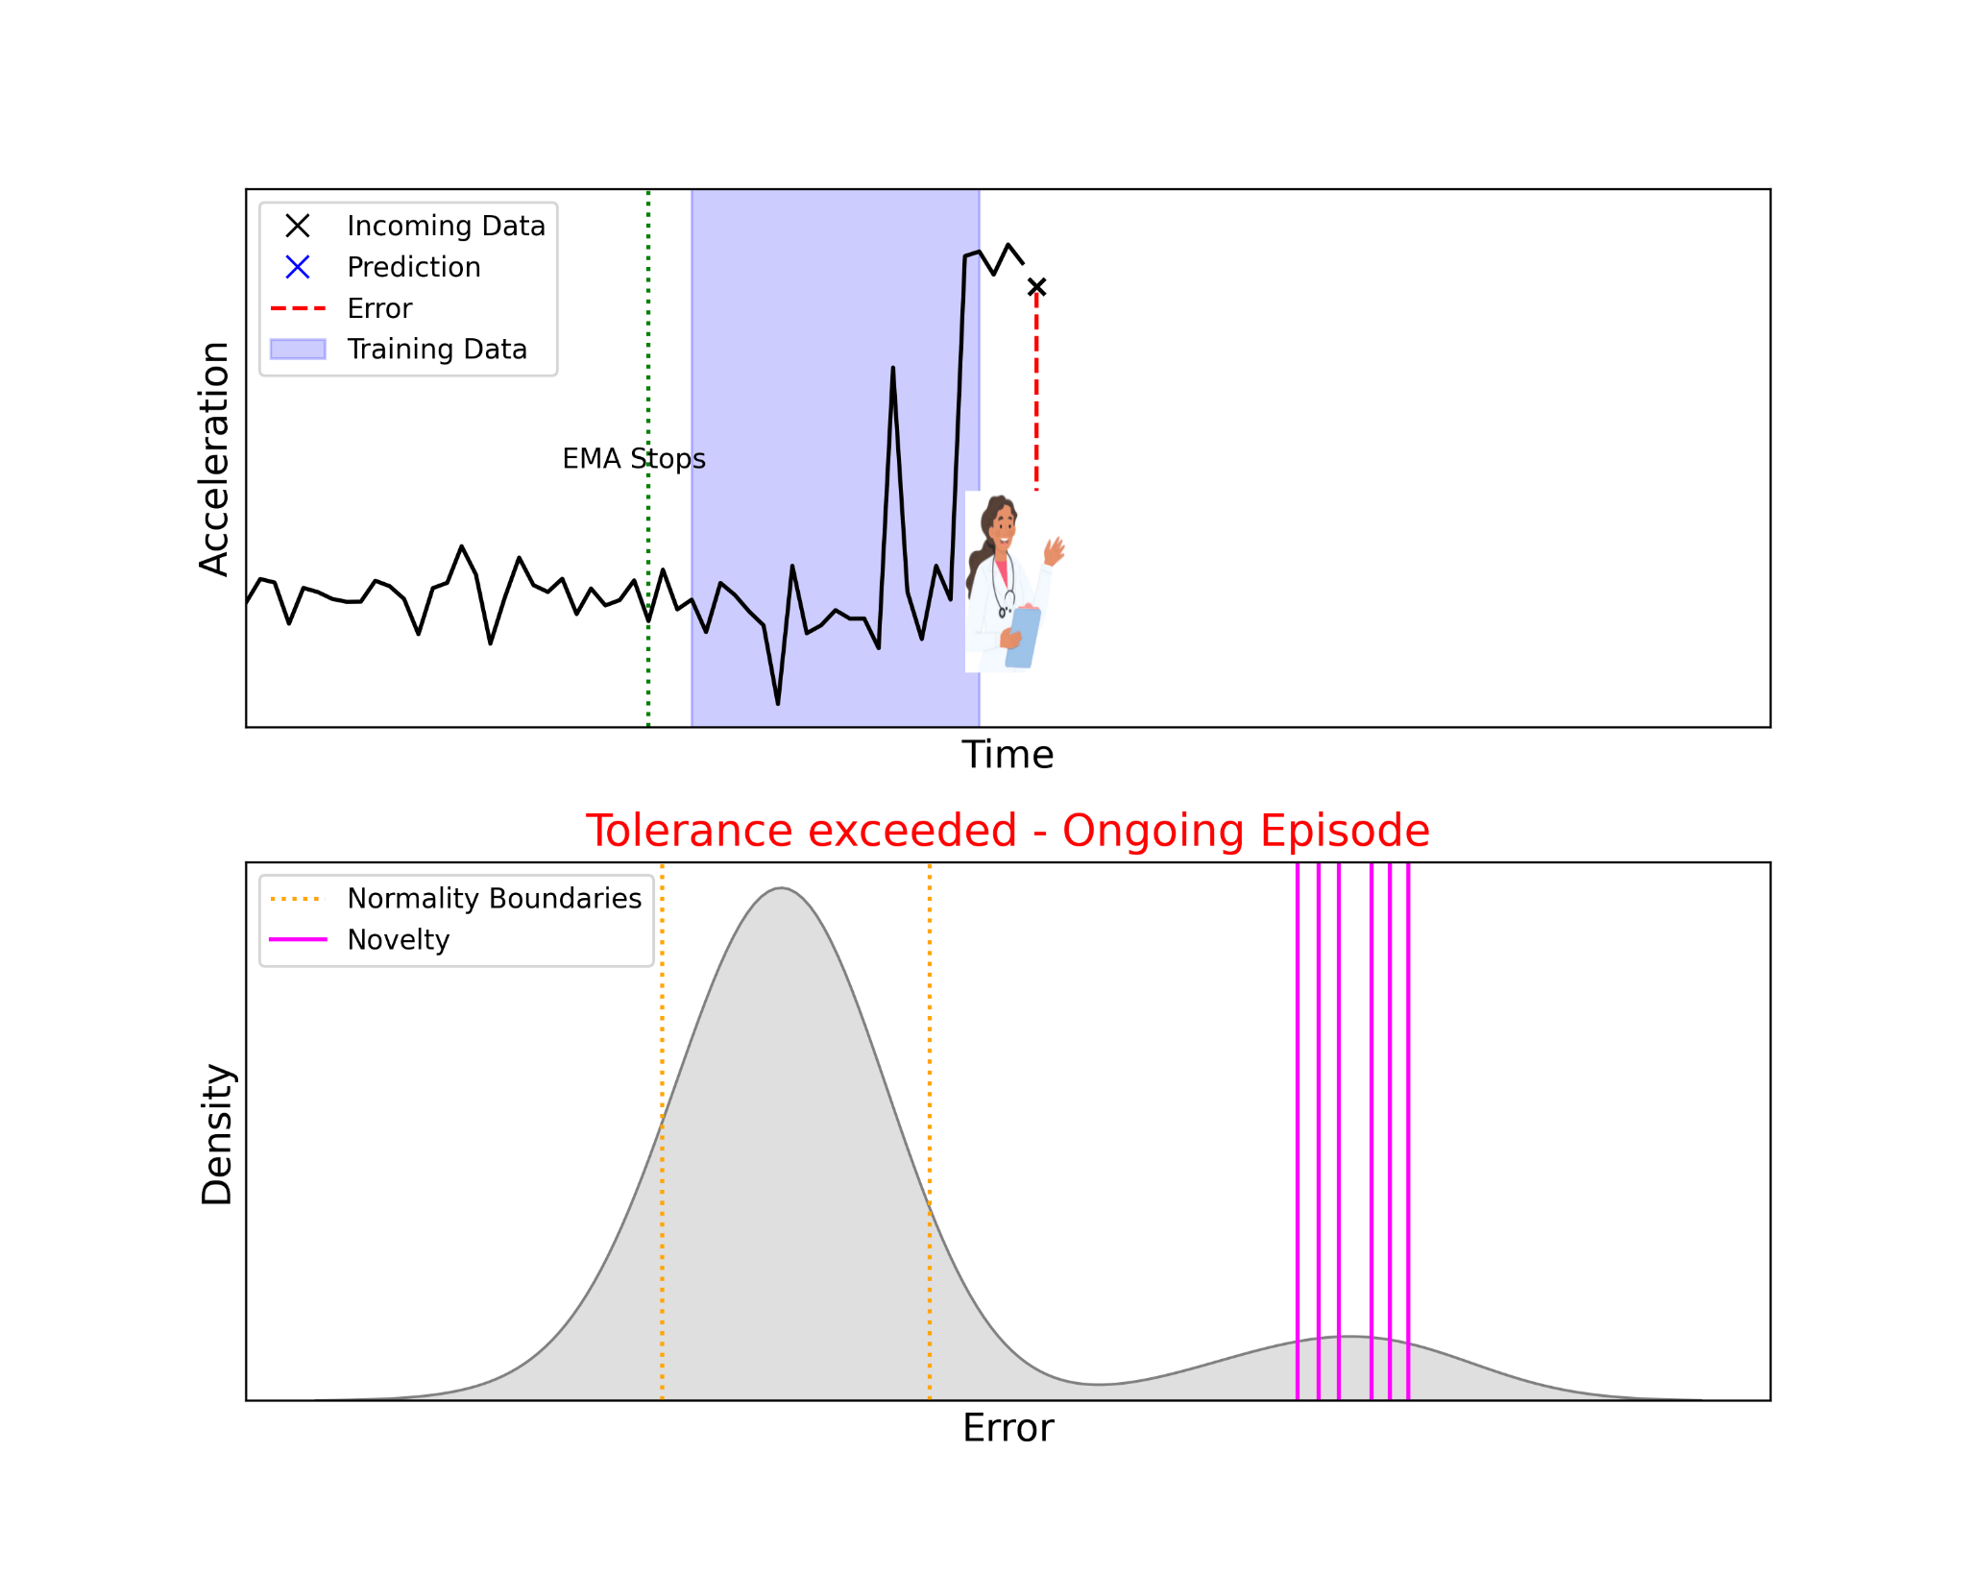
Bipolar Disorder as a Use Case
Novelty Detection
53

Slide 54
Bipolar Disorder as a Use Case
Novelty Detection
54

Slide 55
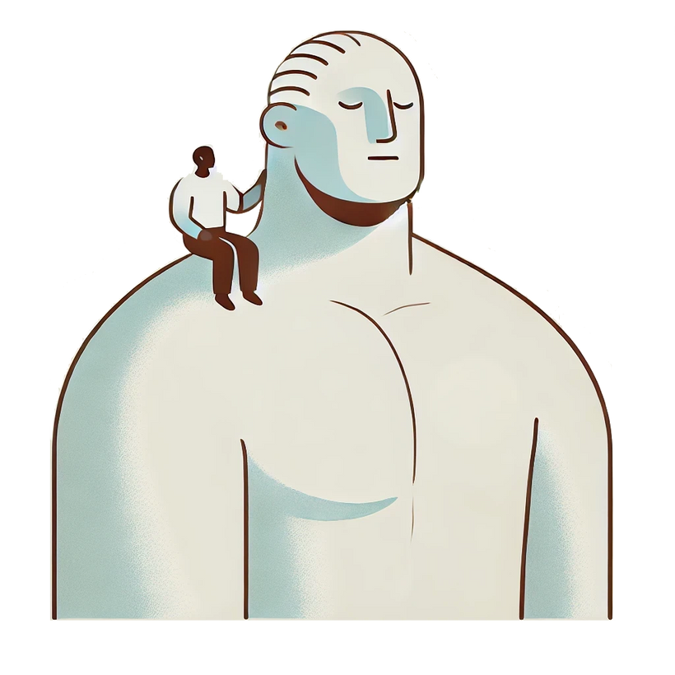
Bipolar Disorder as a Use Case
Transfer Learning
Standing on the Shoulder of Giants
55

Slide 56
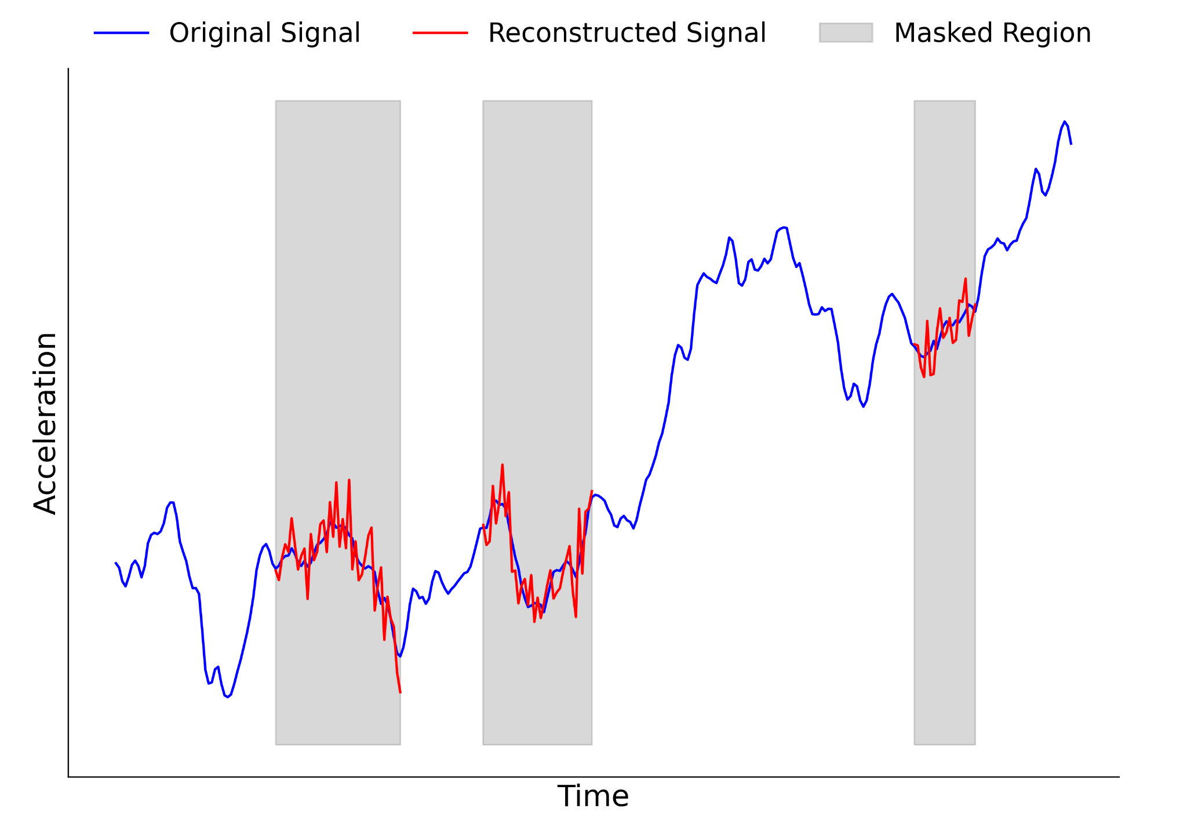
Bipolar Disorder as a Use Case
Transfer Learning
56

Slide 57
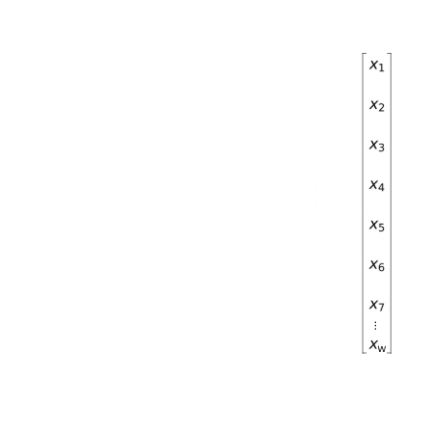
Bipolar Disorder as a Use Case
Transfer Learning
57

Slide 58
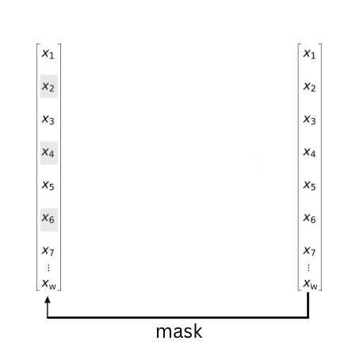
Bipolar Disorder as a Use Case
Transfer Learning
58

Slide 59
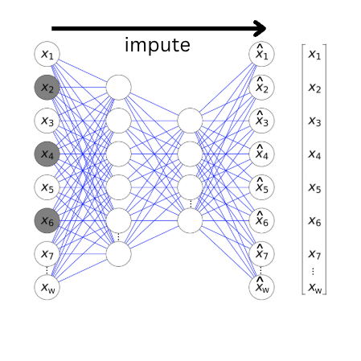
Bipolar Disorder as a Use Case
Transfer Learning
59

Slide 60
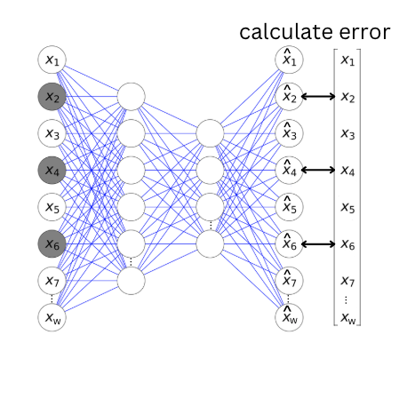
Bipolar Disorder as a Use Case
Transfer Learning
60

Slide 61
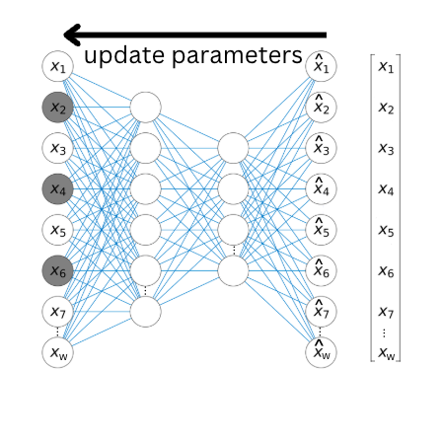
Bipolar Disorder as a Use Case
Transfer Learning
61

Slide 62

Bipolar Disorder as a Use Case
Transfer Learning
62

Slide 63

Bipolar Disorder as a Use Case
Transfer Learning
63

Slide 64
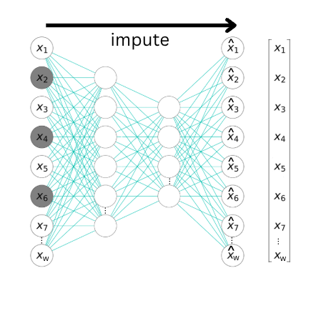
Bipolar Disorder as a Use Case
Transfer Learning
64

Slide 65
Bipolar Disorder as a Use Case
Transfer Learning
65

Slide 66
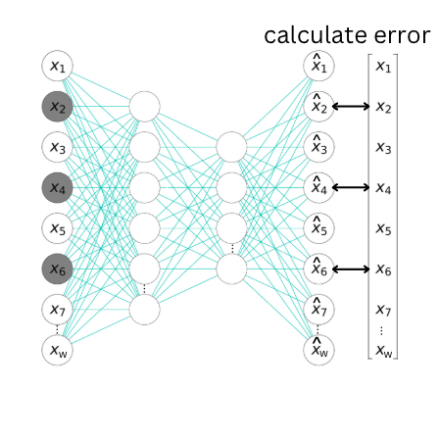
Bipolar Disorder as a Use Case
Transfer Learning
66

Slide 67
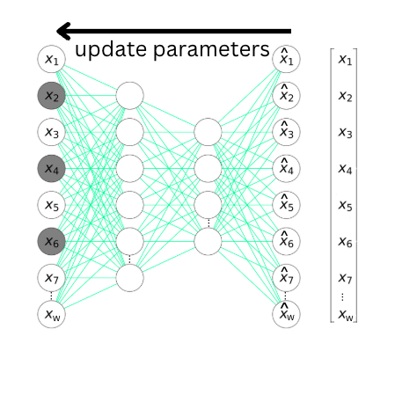
Bipolar Disorder as a Use Case
Transfer Learning
67

Slide 68
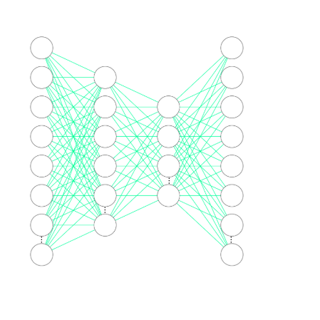
Bipolar Disorder as a Use Case
Transfer Learning
68

Slide 69
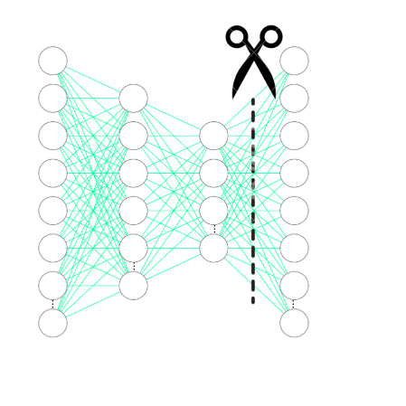
Bipolar Disorder as a Use Case
Transfer Learning
69

Slide 70
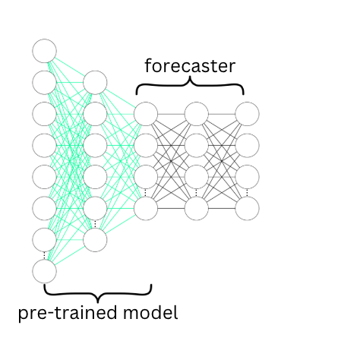
Bipolar Disorder as a Use Case
Transfer Learning
70

Slide 71



Resources & Contact
Mathematics for Machine Learning Book by A. Aldo Faisal, Cheng Soon Ong, and Marc Peter Deisenroth
Understanding Deep Learning Book by Simon J. D. Prince
3Blue1Brown YouTube channel by Grant Sanderson
Contact Me
f.corponi@imperial.ac.uk
Division of Psychiatry, Imperial College London
2nd Floor Commonwealth Building
Du Cane Road
London
W12 0NN
filippocmc.github.io
71

